Slide 1

The Economics of Money, Banking, and Financial Markets
Twelfth Edition, Global Edition
Chapter 8
An Economic Analysis of Financial Structure
Copyright © 2019 Pearson Education, Ltd.
Notes:
If this PowerPoint presentation contains mathematical equations, you may need to check that your computer has the following installed:
1) MathType Plugin
2) Math Player (free versions available)
3) NVDA Reader (free versions available)

Slide 2
Preview
A healthy and vibrant economy requires a financial system that moves funds from people who save to people who have productive investment opportunities.

Slide 3
Learning Objectives (1 of 2)
Identify eight basic facts about the global financial system.
Summarize how transaction costs affect financial intermediaries.
Describe why asymmetric information leads to adverse selection and moral hazard.
Recognize adverse selection and summarize the ways in which they can be reduced.

Slide 4
Learning Objectives (2 of 2)
Recognize the principal-agent problem arising from moral hazard in equity contracts and summarize the methods for reducing it.
Summarize the methods used to reduce moral hazard in debt contracts.

Slide 5
Basic Facts About Financial Structure Throughout the World (1 of 3)
This chapter provides an economic analysis of how our financial structure is designed to promote economic efficiency.
The bar chart in Figure 1 shows how American businesses financed their activities using external funds (those obtained from outside the business itself) in the period 1970–2000 and compares U.S. data to those of Germany, Japan, and Canada.

Slide 6
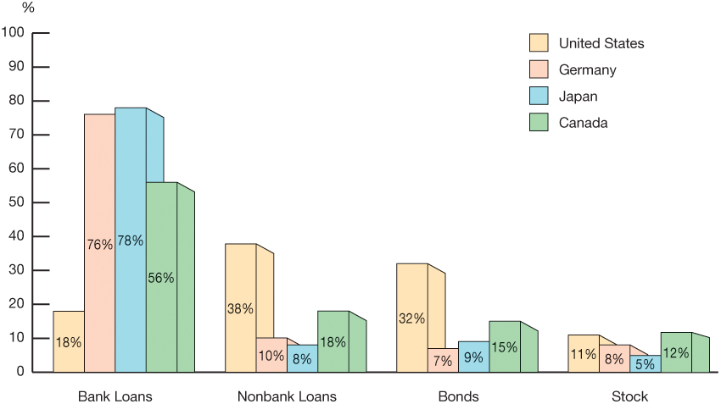
Figure 1 Sources of External Funds for Nonfinancial Businesses: A Comparison of the United States with Germany, Japan, and Canada
Source: Andreas Hackethal and Reinhard H. Schmidt, “Financing Patterns: Measurement Concepts and Empirical Results,” Johann Wolfgang Goethe-Universitat Working Paper No. 125, January 2004. The data are from 1970–2000 and are gross flows as percentage of the total, not including trade and other credit data, which are not available.

Slide 7
Basic Facts About Financial Structure Throughout the World (2 of 3)
Stocks are not the most important sources of external financing for businesses.
Issuing marketable debt and equity securities is not the primary way in which businesses finance their operations.
Indirect finance is many times more important than direct finance
Financial intermediaries, particularly banks, are the most important source of external funds used to finance businesses.

Slide 8
Basic Facts About Financial Structure Throughout the World (3 of 3)
The financial system is among the most heavily regulated sectors of the economy.
Only large, well-established corporations have easy access to securities markets to finance their activities.
Collateral is a prevalent feature of debt contracts for both households and businesses.
Debt contracts are extremely complicated legal documents that place substantial restrictive covenants on borrowers.

Slide 9
Transaction Costs
Financial intermediaries have evolved to reduce transaction costs.
  Economies of scale
  Expertise

Slide 10
Asymmetric Information: Adverse Selection and Moral Hazard
Adverse selection occurs before a transaction occurs.
Moral hazard arises after the transaction has developed.
Agency theory analyses how asymmetric information problems affect economic behavior.

Slide 11
The Lemons Problem: How Adverse Selection Influences Financial Structure
If quality cannot be assessed, the buyer is willing to pay at most a price that reflects the average quality.
Sellers of good quality items will not want to sell at the price for average quality.
The buyer will decide not to buy at all because all that is left in the market is poor quality items.
This problem explains fact 2 and partially explains fact 1.

Slide 12
Tools to Help Solve Adverse Selection Problems
Private production and sale of information
  Free-rider problem
Government regulation to increase information
  Not always works to solve the adverse selection problem, explains Fact 5
Financial intermediation
  Explains facts 3, 4, & 6
Collateral and net worth
  Explains fact 7

Slide 13
The Enron Implosion
Enron Corporation declared bankruptcy in December 2001, up to that point the largest bankruptcy declaration in U.S. history
The Enron collapse illustrates that government regulation can lessen asymmetric information problems but cannot eliminate them. The Enron bankruptcy not only increased concerns in financial markets about the quality of accounting information supplied by corporations but also led to hardship for many of the firm’s former employees, who found that their pensions had become worthless

Slide 14
How Moral Hazard Affects the Choice Between Debt and Equity Contracts
Called the Principal-Agent Problem:
  Principal: less information (stockholder)
  Agent: more information (manager)
Separation of ownership and control of the firm
  Managers pursue personal benefits and power rather than the profitability of the firm.

Slide 15
Tools to Help Solve the Principal-Agent Problem
Monitoring (Costly State Verification)
  Free-rider problem
  Fact 1
Government regulation to increase information
  Fact 5
Financial Intermediation
  Fact 3
Debt Contracts
  Fact 1

Slide 16
How Moral Hazard Influences Financial Structure in Debt Markets
Borrowers have incentives to take on projects that are riskier than the lenders would like.
  This prevents the borrower from paying back the loan.

Slide 17
Tools to Help Solve Moral Hazard in Debt Contracts
Net worth and collateral
  Incentive compatible
Monitoring and enforcement of restrictive covenants
  Discourage undesirable behavior
  Encourage desirable behavior
  Keep collateral valuable
  Provide information
Financial intermediation
  Facts 3 & 4

Slide 18
Summary Table 1 Asymmetric Information Problems and Tools to Solve Them (1 of 2)
Asymmetric Information Problem | Tools to Solve It | Explains Fact Number
Adverse selection | Private production and sale of information | 1, 2
Blank | Government regulation to increase information | 5
Blank | Financial intermediation | 3, 4, 6
Blank | Collateral and net worth | 7
Moral hazard in equity contracts (principal–agent problem) | Production of information: monitoring | 1
Blank | Government regulation to increase information | 5
Blank | Financial intermediation | 3
Blank | Debt contracts | 1

Slide 19
Summary Table 1 Asymmetric Information Problems and Tools to Solve Them (2 of 2)
Asymmetric Information Problem | Tools to Solve It | Explains Fact Number
Moral hazard in debt contracts | Collateral and net worth | 6, 7
Blank | Monitoring and enforcement of restrictive covenants | 8
Blank | Financial intermediation | 3, 4
Note: List of facts:
1. Stocks are not the most important source of external financing.
2. Marketable securities are not the primary source of financing.
3. Indirect finance is more important than direct finance.
4. Banks are the most important source of external funds.
5. The financial system is heavily regulated.
6. Only large, well-established firms have access to securities markets.
7. Collateral is prevalent in debt contracts.
8. Debt contracts have numerous restrictive covenants.

Slide 20
Application: Financial Development and Economic Growth (1 of 2)
Financial repression created by an institutional environment is characterized by:
  Poor system of property rights (unable to use collateral efficiently)
  Poor legal system (difficult for lenders to enforce restrictive covenants)
  Weak accounting standards (less access to good information)
  Government intervention through directed credit programs and state-owned banks (less incentive to proper channel funds to its most productive use)

Slide 21
Application: Financial Development and Economic Growth (2 of 2)
The financial systems in developing and transition countries face several difficulties that keep them from operating efficiently.
In many developing countries, the system of property rights (the rule of law, constraints on government expropriation, absence of corruption) functions poorly, making it hard to use these two tools effectively.

Slide 22
The Tyranny of Collateral
To use property, such as land or capital, as collateral, a person must legally own it. Unfortunately, it is extremely expensive and time-consuming for the poor in developing countries to make their ownership of property legal.
When the financial system is unable to use collateral effectively, the adverse selection problem worsens because the lender needs even more information about the quality of the borrower in order to distinguish a good loan from a bad one. Little lending will take place, especially in transactions that involve collateral, such as mortgages.

Slide 23
Application: Is China a Counterexample to the Importance of Financial Development?
As China gets richer, the strategy of maintaining a high savings rate to support economic growth is unlikely to continue to work. China will need to allocate its capital more efficiently, which requires that it improve its financial system. The Chinese leadership is well aware of this challenge; the government has announced that state-owned banks are being put on the path to privatization.

