Slide 1
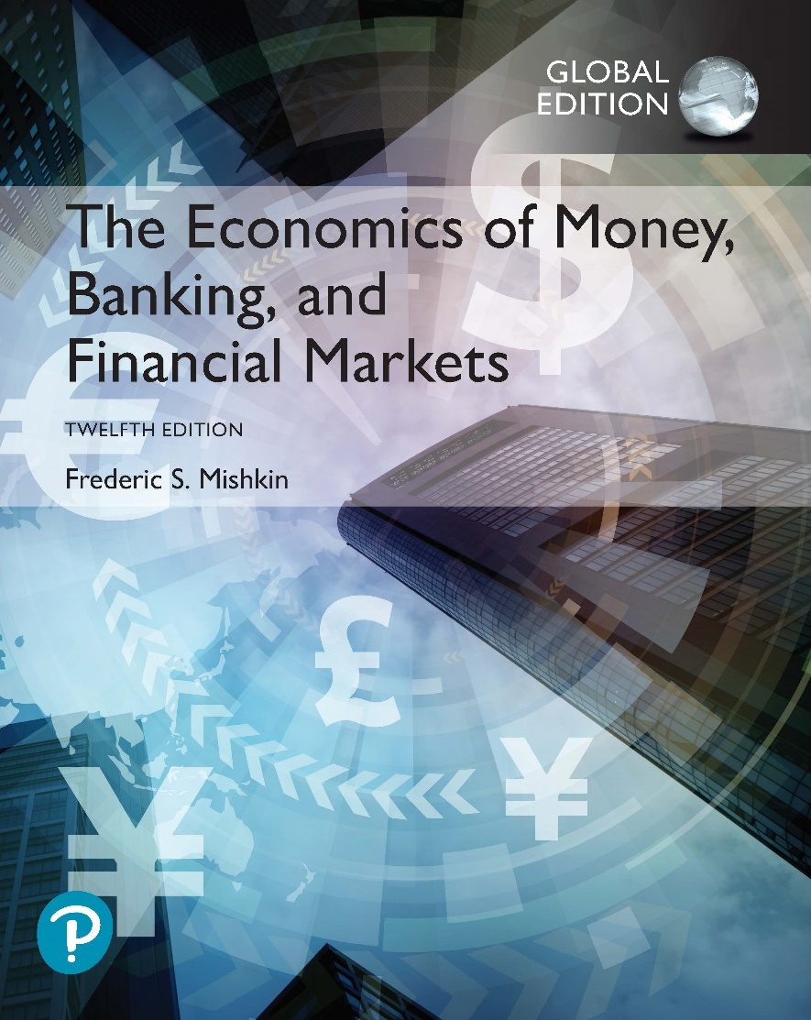
The Economics of Money, Banking, and Financial Markets
Twelfth Edition, Global Edition
Chapter 4
The Meaning of Interest Rates
Copyright © 2019 Pearson Education, Ltd.
Notes:
If this PowerPoint presentation contains mathematical equations, you may need to check that your computer has the following installed:
1) MathType Plugin
2) Math Player (free versions available)
3) NVDA Reader (free versions available)

Slide 2
Preview
Before we can go on with the study of money, banking, and financial markets, we must understand exactly what the phrase interest rates means. In this chapter, we see that a concept known as the yield to maturity is the most accurate measure of interest rate.

Slide 3
Learning Objectives
Calculate the present value of future cash flows and the yield to maturity on the four types of credit market instruments.
Recognize the distinctions among yield to maturity, current yield, rate of return, and rate of capital gain.
Interpret the distinction between real and nominal interest rates.

Slide 4
Measuring Interest Rates
Present value: a dollar paid to you one year from now is less valuable than a dollar paid to you today.
  Why: a dollar deposited today can earn interest and become $1×(1+i) one year from today.
  To understand the importance of this notion, consider the value of a $20 million lottery payout today versus a payment of $1 million per year for each of the next 20 years. Are these two values the same?

Slide 5
Present Value
Let i = .10
In one year: $100 × (1 + 0.10) = $110
In two years: $110 × (1 + 0.10) = $121
or $100 × (1 + 0.10)²
In three years: $121 × (1 + 0.10) = $133
or $100 × (1 + 0.10)³
In n years
$100 × (1 + i)^{n}

Slide 6
Simple Present Value (1 of 2)
PV = today’s (present) value
CF = future cash flow (payment)
i = the interest rate

Slide 7
Simple Present Value (2 of 2)
Cannot directly compare payments scheduled in different points in the time line

Slide 8
Four Types of Credit Market Instruments
Simple Loan
Fixed Payment Loan
Coupon Bond
Discount Bond

Slide 9
Yield to Maturity
Yield to maturity: the interest rate that equates the present value of cash flow payments received from a debt instrument with its value today

Slide 10
Yield to Maturity on a Simple Loan

Slide 11
Fixed-Payment Loan
The same cash flow payment every period throughout the life of the loan
LV = loan value
FP = fixed yearly payment
n = number of years until maturity

Slide 12
Coupon Bond (1 of 4)
Using the same strategy used for the fixed-payment loan:
P = price of coupon bond
C = yearly coupon payment
F = face value of the bond
n = years to maturity date

Slide 13
Coupon Bond (2 of 4)
When the coupon bond is priced at its face value, the yield to maturity equals the coupon rate.
The price of a coupon bond and the yield to maturity are negatively related.
The yield to maturity is greater than the coupon rate when the bond price is below its face value.

Slide 14
Coupon Bond (3 of 4)
Table 1 Yields to Maturity on a 10%-Coupon-Rate Bond Maturing in Ten Years (Face Value = $1,000)
Price of Bond ($) | Yield to Maturity (%)
1,200 | 7.13
1,100 | 8.48
1,000 | 10.00
900 | 11.75
800 | 13.81

Slide 15
Coupon Bond (4 of 4)
Consol or perpetuity: a bond with no maturity date that does not repay principal but pays fixed coupon payments forever
P = C / i_{c}
P_{c} = price of the consol
C = yearly interest payment
I_{c} = yield to maturity of the consol
can rewrite above equation as this: i_{c} = C/P_{c}
For coupon bonds, this equation gives the current yield, an easy to calculate approximation to the yield to maturity

Slide 16
Discount Bond
For any one year discount bond
F = Face value of the discount bond
P = Current price of the discount bond
The yield to maturity equals the increase in price over the year divided by the initial price.
As with a coupon bond, the yield to maturity is negatively related to the current bond price.

Slide 17
The Distinction Between Interest Rates and Returns (1 of 4)
Rate of Return:

Slide 18
The Distinction Between Interest Rates and Returns (2 of 4)
The return equals the yield to maturity only if the holding period equals the time to maturity.
A rise in interest rates is associated with a fall in bond prices, resulting in a capital loss if time to maturity is longer than the holding period.
The more distant a bond’s maturity, the greater the size of the percentage price change associated with an interest-rate change.
Interest rates do not always have to be positive as evidenced by recent experience in Japan and several European states.

Slide 19
The Distinction Between Interest Rates and Returns (3 of 4)
The more distant a bond’s maturity, the lower the rate of return the occurs as a result of an increase in the interest rate.
Even if a bond has a substantial initial interest rate, its return can be negative if interest rates rise.

Slide 20
The Distinction Between Interest Rates and Returns (4 of 4)
Table 2 One-Year Returns on Different-Maturity 10%-Coupon-Rate Bonds When Interest Rates Rise from 10% to 20%
(1) Years to Maturity When Bond Is Purchased | (2) Initial Current Yield (%) | (3) Initial Price ($) | (4) Price Next Year* ($) | (5) Rate of Capital Gain (%) | (6) Rate of Return [col (2) + col (5)] (%)
30 | 10 | 1,000 | 503 | −49.7 | −39.7
20 | 10 | 1,000 | 516 | −48.4 | −38.4
10 | 10 | 1,000 | 597 | −40.3 | −30.3
5 | 10 | 1,000 | 741 | −25.9 | −15.9
2 | 10 | 1,000 | 917 | −8.3 | +1.7
1 | 10 | 1,000 | 1,000 | 0.0 | +10.0
*Calculated with a financial calculator, using Equation 3.

Slide 21
Maturity and the Volatility of Bond Returns: Interest-Rate Risk
Prices and returns for long-term bonds are more volatile than those for shorter-term bonds.
There is no interest-rate risk for any bond whose time to maturity matches the holding period.

Slide 22
The Distinction Between Real and Nominal Interest Rates
Nominal interest rate makes no allowance for inflation.
Real interest rate is adjusted for changes in price level so it more accurately reflects the cost of borrowing.
  Ex ante real interest rate is adjusted for expected changes in the price level
  Ex post real interest rate is adjusted for actual changes in the price level

Slide 23
Fisher Equation

Slide 24
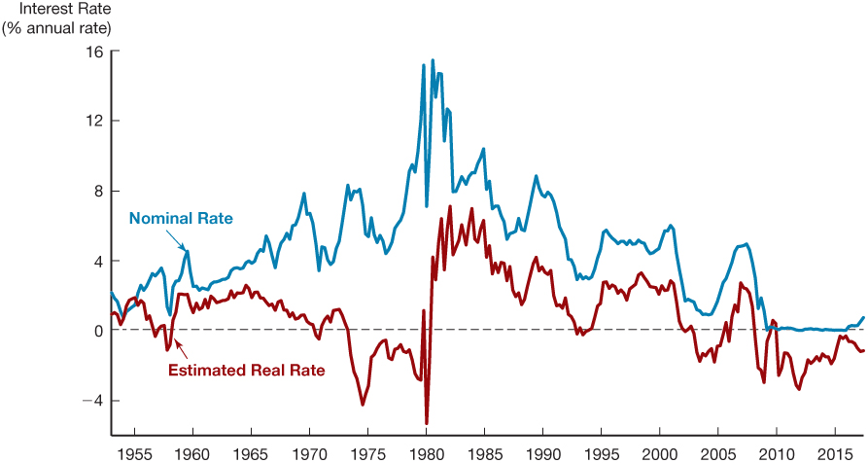
Figure 1 Real and Nominal Interest Rates (Three-Month Treasury Bill), 1953–2017
Sources: Nominal rates from Federal Reserve Bank of St. Louis FRED database: http://research.stlouisfed.org/fred2/. The real rate is constructed using the procedure outlined in Frederic S. Mishkin, “The Real Interest Rate: An Empirical Investigation,” Carnegie-Rochester Conference Series on Public Policy 15 (1981): 151–200. This procedure involves estimating expected inflation as a function of past interest rates, inflation, and time trends, and then subtracting the expected inflation measure from the nominal interest rate.

