Slide 1
Simple Past

Slide 2
I watched a film yesterday
When you were young you had a very expensive car
They went to England last summer

Slide 3
PAST SIMPLE
I | was
You | were
He/She/It | was
We | were
You | were
They | were
TO BE
Verbi regolari
Verbi irregolari
FORMA BASE + ED
Imparare a memoria il paradigma

Slide 4
TO BE
I | was
You | were
He/She/It | was
We | were
You | were
They | were
wasn’t
weren’t
wasn’t
weren’t
Was I ? | Wasn’t. I?
Were you? | Weren’t. You?
Was he/she/it? | Wasn’t. He/she/it?
We? Were you? they? | we? Weren’t. You? they?
SOGG + WAS/WERE
SOGG + WAS/WERE + NOT
WAS/WERE + SOGG
WASN’T/WEREN’T + SOGG
Yesterday she was very angry
Yesterday she wasn’t very angry
Was she angry yesterday?
Wasn’t she angry yesterday?

Slide 5
Verbi regolari
Affermativa | Negativa | Interrogativa | Int/negativa
S+ verbo+ED To watch – watched To start- started I started doing karate when I was 7 years old | S+DID+NOT+verboBase Sue didn’t start any sport when she was 7 years old | DID+S+verboBase ..? When did the cinema open last Saturday? | DIDN’T+S+verboBase? Didn’t you want some beer yesterday at dinner?

Slide 6
Spelling variations when adding -ED
Verbi monosillabici che sono costituiti da Consonante+Vocale+Consonante (CVC), raddoppiano l’ultima consonante:
Ex. Fit- fitted; stop- stopped
Verbi bisillabici che terminano in Consonante+Vocale+Consonante (CVC), raddoppiano la consonante finale solo se questo gruppo ha la vocale accentata; nel British English, questa regola vale al contrario se il verbo termina in –l (cioè: si raddoppia la –l, solo se la sillaba precedente è accentata)
Admìt – admitted
Tràvel – travelled (BrEn) traveled (AmEn)
Verbi che terminano in Consonante+y (C+y), cambiano la –y in –i:
cry- cried; study-studied
Verbi che terminano in Vocale+y (V+y), rimangono invariati:
play – played; enjoy- enjoyed

Slide 7
Verbi irregolari
Affermativa | Negativa | Interrogativa | Int/negativa
S+ verbo irr. To read – read My grandpa read me the newspaper when I was a kid | S+DID+NOT+verboIrr.Base Sue didn’t go to meet her friends because she was ill | DID+S+verboIrr.Base ..? What did you choose to order yesterday at the restaurant? | DIDN’T+S+verboIrr.Base? Didn’t you catch the bus?

Slide 8
Il paradigma dei verbi irregolari si deve imparare a memoria
Forma base | Past simple | Past participle
be | Was/were | Been
Become | Became | Become
Break | Broke | Broken
Bring | Brought | Brought
Build | Built | Built
Come | Came | Come
Cost | Cost | Cost
Cut | Cut | Cut
Meet | Met | Met
Put | Put | Put
Read | Read | Read

Slide 9
USO
Azione passata, verificatasi in un tempo concluso
= LAST YEAR/MONTH/WEEK/DAY/WEEKEND, YESTERDAY, 3 YEARS AGO, IN (2012), WHEN (I was a child)
Il momento in cui si è conclusa l’azione è sempre specificato con un indicatore temporale

Slide 10
She has got big blue eyes
PRESENT SIMPLE
PAST SIMPLE ??
She has a chat with her friend every weekend

Slide 11
She has got big blue eyes
v. forte
She had big blue eyes
PRESENT SIMPLE
PAST SIMPLE ??
She has a chat with her friend every weekend
v. debole
She had a chat with her friend every weekend
HAVE GOT esiste solo al present simple
TO HAVE può avere significato:
Possesso
Altri significati (cfr. espressioni idiomatiche)
Negli altri tempi viene usato TO HAVE (v debole)
Si può usare in tutti i tempi verbali
PARADIGMA
Have Had Had

Slide 12
She has got big blue eyes
She had big blue eyes
She didn’t have big blue eyes
Did she have big blue eyes?
PRESENT SIMPLE
PAST SIMPLE ??
She has a chat with her friend every weekend
She had a chat with her friend every weekend
She didn’t have a chat with her friend every weekend
Did she have a chat with her friend every weekend?
Ausiliare DID (al passato)

Slide 13
She has got big blue eyes
She had big blue eyes
She didn’t have big blue eyes
Did she have big blue eyes?
PRESENT SIMPLE
PAST SIMPLE ??
She has a chat with her friend every weekend
She had a chat with her friend every weekend
She didn’t have a chat with her friend every weekend
Did she have a chat with her friend every weekend?
Ausiliare DID (al passato)
Presente
VERBO FORTE >> funge da aus.
She hasn’t got big blue eyes
Has she got big blue eyes?
VERBO DEBOLE Necessita l’aus. >> DO/DOES
She doesn’t have a chat with her friend every weekend
Does she have a chat with her friend every weekend?

Slide 14
Exercise 1. (regular verbs) Put the verbs into brackets in past simple
My mother ____________ (call) me at 7
I ________ (wash) and ________ (dress) very quickly
Yesterday, I _________ (walk) to school
After lunch, I ________ (watch) TV with my cousins
First, I ______ (have) lunch, then I _____ (play) basketball with my friends
At 8.30 we _________ (finish) the game
Before bedtime, I _______ (telephone) my girlfriend
The train ________ (stop) at Birmingham station
John ________ (visit) his grandparents a lot when he _____ (be) a child
We __________ (invite) lots of people to our party

Slide 15
Exercise 2. Transform the sentences into neg., aff. or int.
She watched TV till late yesterday (- ), ( ?)
Did you listen to the news last week? ( + ), (-)
The boys didn’t follow the class two days ago (+ ), (?)
They walked to school every day when they were young (- ), (?)
Did you enjoy the last movie on TV? (+), ( - )
The 6th March 2020 they ended their career as business consultants (- ), ( ?)
John had a shower and he went to bed (-)
She had a very good time at the party yesterday ( - ), (?)
My sister was born the 1st April 1998 (-), (?)
You didn’t have coffee after lunch (?), ( +)
She was very angry because she lost her keys (-), (?)
They weren’t in a hurry (?), (+)

Slide 16
Exercise 3. (Irregular verbs) Put the verbs between brackets into simple past
The last lesson (begin) _______ at 2.30 last year
Two days ago, Joe (feel) _____ ill after lunch
Suddenly, a bird (fly) ______ in through the window
I believe you (do) ____ the wrong thing with your mother
Yesterday morning, Jane (get) ____ ready very quickly
Yesterday night, we (know) ____ all the answers of the quiz
The students (learn) _____ many things last year with this professor
When I (be) ___ a child, I (write) _____ a letter every week
Yesterday Anna (be) _____ very hungry, so she (eat) ____ two courses of spaghetti
We _______ (not know) the time, so Nick (tell) _____ us

Slide 17
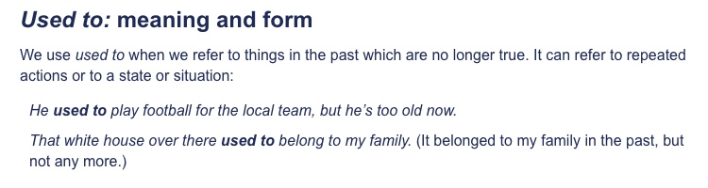
USED TO

Slide 18
USED TO
USED TO + forma base
“essere soliti/solere” = azioni che avvenivano regolarmente nel passato

Slide 19
SOGG + DID+ NOT + USE TO + Vbase
DID + SOGG + USE TO + Vbase
It didn’t use to be so crowded in the shops as it is today
Did she use to work in the same street as us?
Yes, she did
No, she didn’t

Slide 20
SOGG + DID+ NOT + USE TO + Vbase
DID + SOGG + USE TO + Vbase
It didn’t use to be so crowded in the shops as it is today
Did she use to work in the same street as us?
Yes, she did
No, she didn’t
Short answer
YES + S +DID
NO+S+DIDN’T

Slide 21
EXERCISE. Create interrogatives/neg or affirmatives with “used to”
Susan/have/a dog? (int)
People/use/mobilephones (neg)
He/go/swimming pool (aff)
They/like/jazz music? (int)
Ewa’s family/live/in Moscow (aff)
We/drink/coffee (neg)

Slide 22
Ex. Rewrite sentences using “used to”
I was in the school tennis team ___________I used to be in the school tennis team______
Sophie had long hair when she was at school ____________________________________
Mary didn’t listen when her teachers were speaking. ______________________________
Riccardo got up at 6 when he was training for the Olympics. ________________________
What did you usually do on Saturday evenings? ___________________________________
We always gave our teachers presents at the end of the term _______________________

Slide 23
Past continuous
Past progressive

Slide 24
They were talking in the lounge
She was going to the park with a friend
Sogg + TO BE (coniugato al pass.)+ BASE FORM + ING
Forma affermativa

Slide 25
They were talking in the lounge
She was going to the park with a friend
Sogg + TO BE (coniugato al pass.)+ BASE FORM + ING
Forma affermativa
L’ausiliare è il verbo TO BE (opportunamente coniugato al passato)
Sogg+ TO BE+ NOT+ BASE FORM + ING
She wasn’t going to the park with a friend
Forma negativa
TO BE+ Sogg+ + BASE FORM + ING
Was she going to the park with a friend?
Forma interrogativa
SHORT ANSWERS
A: Were you going to work yesterday at 8am?
B: No, I wasn’t/ Yes, I was

Slide 26
Usi
Esprimere un’azione in corso di svolgimento in un momento nel passato
Es. At 9 this morning I was driving to work
Azioni che si svolgono contemporaneamente nel passato
Es. While I was cycling my brother was probably sleeping on the couch
Per enfatizzare la durata di un’azione nel passato
Es. My friend was phoning me to tell me about the horrible adventure he had
Azione in corso di svolgimento nel passato che è stata interrotta da un altro evento
Es. Jim broke his leg while he was playing volleyball

Slide 27
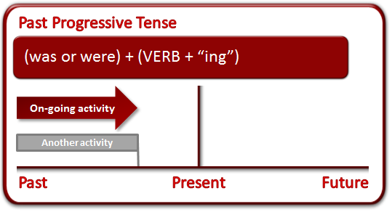
PAST SIMPLE E PAST CONTINUOUS
Per esprimere un’azione corso di svolgimento nel passato che viene interrotta da un altro evento
PAST CONTINUOUS
PAST SIMPLE
While I was waiting for the bus
While I was waiting for the bus I saw an accident
I saw an accident

Slide 28
While I was waiting for the bus I saw an accident
When I was waiting for the bus I saw an accident
When I saw an accident, I was waiting for the bus
WHEN (quando) + PAST SIMPLE
PAST CONTINUOUS
azione in svolgimento (azione lunga) o evento improvviso

Slide 29
While I was waiting for the bus I saw an accident
When I was waiting for the bus I saw an accident
When I saw an accident, I was waiting for the bus
WHEN (quando) + PAST SIMPLE
PAST CONTINUOUS
azione in svolgimento (azione lunga) o evento improvviso
WHILE (mentre) +
PAST CONTINUOUS
Azione in corso di svolgimento

Slide 30
While I was waiting for the bus I saw an accident
When I was waiting for the bus I saw an accident
When I saw an accident, I was waiting for the bus
WHEN (quando) + PAST SIMPLE
PAST CONTINUOUS
azione in svolgimento (azione lunga) o evento improvviso
WHEN + short/long action
They met while she was studying in London
They met when she was studying in London
When he turned on the oven, the fire alarm went off
While he turned on...
WHILE (mentre) +
PAST CONTINUOUS
Azione in corso di svolgimento
WHILE + long action

Slide 31
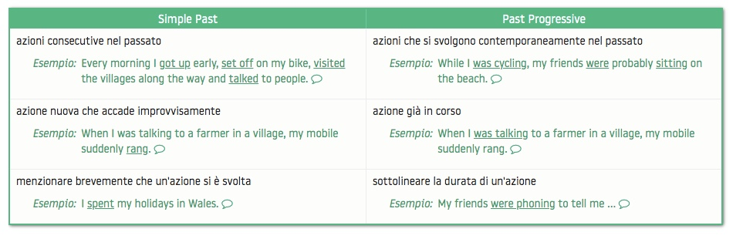
successione

Slide 32
Verbi che non si usano nella forma progressiva
Così come accade per il present continuous, anche per il past continuous ci sono dei verbi che non si usano in questa forma. Ripassiamoli:
verbi di stato (stative verbs) che esprimono una condizione
be, cost, fit, mean, remain, suit
The weather was awful.
verbi che esprimono possesso o appartenenza
belong, have
I didn’t have a lot of luggage.
verbi di percezione
feel, hear, see, smell, taste, touch
I saw many villages.
verbi che esprimono sentimenti
hate, hope, like, love, prefer, regret, want, wish
My friends preferred to spend their holidays by the sea.
verbi di pensiero e verbi che sprimono conoscenza
believe, know, realize, recognize, seem, think, understand
I thought they would be sitting at the beach all day.

Slide 33
Exercise. Put the sentences in neg., aff. or interr.
Tima was drawing pictures
Kate and Bill weren’t looking outside the window
Were Eddie and Lisa reading a book?
Paula and Jim were writing an exercise on the board
Anna wasn’t performing an experiment
Last year Erik was traveling a lot
He was beginning to experiment with new equipment
They were testing the product

Slide 34
Exercise. Choose the correct verb form
While she performed/was performing the experiment, her teacher looked/was looking at her
Jim was playing/played with his friend when he fell/was falling in the ground
While she performed/was performing the experiment, I had/was having an idea
When I was arriving/arrived, I went/was going to the kitchen
We were finding/found an old box while we were digging/dug in the garden
I was seeing/saw an old friend while I was waiting/waited for the train
While I had/was having a bath, the phone rang.
When we were walking/walked in the woods, a thunderstorm broke out/was breaking out

Slide 35
Exercise. Complete with Simple Past or Past Progressive
1. While Steve _____________ (watch) football on TV, Monica _________ (listen) to the radio.
2. When I ____________ (walk) down Fifth Avenue, I __________ (discover) a wonderful boutique.
3. The angry little girl ______________ (throw) her toy onto the floor and ___________ (stamp) her foot.
4. I _________(receive) your SMS while I __________ (sit) in the doctor’s waiting room.
When Ruth __________ (be) little, she _________ (hate) the smell of coffee.
Yesterday I ______ (get up), ______ (have a shower) and immediately _______ (drive) to work because I ______ (be) late
While Anna _________ (train) at the gym, her lazy friend _______ (lay) in bed
She ______ (hear) a terrible noise and suddenly she _______ (run) away

