Slide 1
German Federalism:
A Blueprint for the Constitutional Reform in Italy?

Slide 2
Structure
Brief overview of German constitutional history
Development of German federalism and its cultural foundation
Types of federalism
Germany‘s second chamber: The „Bundesrat“
Impact of the discussed constitutional reforms on the „Senato“
Impact of the reforms on the state‘s structure
Is German federalism actually a blueprint for the constitutional reforms?

Slide 3
I. Brief overview of German constitutional history
Before there was a souvereign German state, there was a multitude of souvereign territories, ruled by the local nobility, which was organized in the Holy Roman Empire
The first try to establish a constitution for a German State was the „Paulskirchenverfassung“ in 1848/1849
First constitution for a German state was the „Bismarcksche Reichsverfassung“, which was used for the „Kaiserreich“ between 1871 and 1919
→ constitutional monarchy

Slide 4
Brief overview of German constitutional history (2)
After WW1 and the resignation of Kaiser Wilhelm II the first German democratic republic was established by the „Weimarer Reichsverfassung“ in 1919
This constitution was formally still in place during the Nazi-era, however, it was partially suspended by the regime
In course of the reorganization of a German federal state in the western part of Germany, the so called „Grundgesetz“ was adopted by the „Parlamentarischer Rat“ as a temporary constitution in 1949
With the German Reunification in 1990 the „Grundgesetz“ became the final constitution for West Germany and East Germany

Slide 5
II. Development of German federalism and its cultural foundation
Between 950-1806 there was a multitude of relatively souverign territorial powers on German soil, that were part of the loose confederation of the Holy Roman Empire
In the aftermath of the Napoleonic wars (1815-1871) there were efforts to create a German national state, however, those plans were never successful.
In 1871 the first all-german federal national state with a constitution was founded under prussian domination as „Deutsches Kaiserreich“ (prussian unitarism!)
The strong federalism of the „Kaiserreich“ was continued during the time of the „Weimarer Republik“, but ultimately came to a break during the era of Nazionalsozialismus between 1933 and 1945 with the establishment of a tolitarian state

Slide 6
II. Development of German federalism and its cultural foundation (2)
  During the reorganization of the (west) German state the implemention and form of a federal system was highly controversial
  In favour of a strong federalistic system was the distinct federal tradition
  Also the allied forces were prefering such a system since it prevents a concentration of power that would have been established with a centralized state („Divide and Rule“)
  Parties with strong regional links were fearing for a loss of power

Slide 7
II. Development of German federalism and its cultural foundation (3)
Finally the independence of the „Länder“ was one of the main principles of the „Grundgesetz“
  Relatively strong competences for legislation on land level
  Additionally direct participation of the governments of the „Länder“ on federal legislation was established by the creation of the legislative body „Bundesrat“ as the parliament‘s second chamber
This legislative body was a novelty since the „Länder“ could directly participate on federal legislation, which made „vertical cooperation“ between the federal instituions and the „Länder“ not only possibile but neccessary
This privilege interacts with the duty of the „Länder“ to execute many federal laws with their administrative apparatus and the financial responsibility
This leads not only to a strong interest of the federal institutions on making practicable laws, because those would otherwise not pass the second chamber but also to a strong interest of the „Länder“ on constructive collaboration as well

Slide 8
II. Development of German federalism and its cultural foundation (4)
The „Bundesrat“ is also a forum for the horizontal cooperation of between the Länder
Examples for horizontal cooperation of the „Länder“ are also cross national advisory committees like the „Kultusministerkonferenz“ (Summit of the ministers of education of the Länder)
Another good example is the equalization fund between the „Länder“

Slide 9
II. Development of German federalism and its cultural foundation (5)
A cooperative federalistic system does not try to conserve a pluralism that was caused by historic or politic reasons but tries to increase the efficiency of public actions by consultations and negotiations.
Germany‘s cooperative federalism is also embodied in Art. 72 II GG and Art. 106 III Nr.2 GG, which name the establishment of equivalent living conditions as a national objective.

Slide 10
II. Development of German federalism and its cultural foundation (6)
The division of competences, namely the legislation competence on the federal level and the execution competence that can mostly be found on land level in Germany, is particular and is called „Kompetenzprinzip“ (competence principle)
Thanks to that it is possible to ensure unity on federal territory through federal legislation but also to execute laws according to the subsidary principle on a lower level (Länder) which makes it possibile to adapt to regional characteristics.

Slide 11
III. Types of Federalism (1)
Federalism
Cooperative Federalism
Competitive Federalism
Italian Regionalism?

Slide 12
III. Types of Federalism (2)
An example for competitive federalism: The United States of America:
  As much autonomy as possibile for the member states: Only those competences that cannot be held by a member state are delegated to the federal level
  Strict separation between federal state and member states on legislative, executive and judiciary level
  Examples: Civil law, which is determined by the member states, federal laws are just executed by federal administration, nearly seperated law system
  Members of the second chamber of the US (Senat) are elected by the population of their respective states, but areare not part of the local government. Also those governments do not have the possibility to decide about the candidates

Slide 13
III. Types of Federalism (3)
Cooperative
Federalism
Competitive
Federalism
Cooperation between the member states as well as between the member states and the federal government
Compromise between autonomy/independence of member states and unity on federal level
→ Germany
As much room for own decisions of the member states regarding legislation as possible
This shall lead to competition on a horizontal level between the member states, that shall reward the most potent ones.
→ USA, Canada, Switzerland

Slide 14
III. Types of Federalism (4)
Italy:
Asymetric Federalism: Autonomous regions have in comparison to the other regions a bigger amount of legislative and administrative powers, as well as more financial independence, which can be explained by the cultural diversity of Italy
Almost no integration of the regioni in the federal legisation, although there is a summit between the federal government and those of the regioni in order to exchange information
It is possible to speak of a „cooperative regionalism“, since fields of jurisdictions that fall under the designation „competenza concorrente“ (Art. 117 Comma 3 cost.), require cooperation between the federal level that sets up a frame work and the regions, that pass laws that regulate details
Shared judicature
At the core area of national execution (Police) the most competence is held by the federal level; especially in this area exist a lot of decentralized federal departments
Because not the rigioni but the comuni are primarily responisble for the execution of (federal) laws, the regioni have a relatively weak position regarding executive competences.

Slide 15
III. Types of Federalism (5)
Conclusion:
At least it is possible to speak of federalism regarding the autonomous regioni
A federal tendency can be sensed as well by the other regioni since the „Riforma del Titolo V“ in 1999-2001, although there are still a lot of attributes of a centralized state in place
There are also significant differences between the autonomous regioni and the other rigioni which hinders federalistic cooperation on a horizontal level
There is also a clear lack of mandatory mechanisms for cooperation between regioni and the federal level
→There are some federal ideas in place that lean towards a cooperative federal system, such as the equilization fund or the summit between the federal government and the local and regional entities

Slide 16
IV. Germany‘s second chamber:
The „Bundesrat“:
Basic Information
Highest federal body through which „the Länder [...] participate [...] in the legislation and administration of the Federation and in matters concerning the European Union“ (Article 50 GG)
69 Members, who are not elected directly by the people but who are represantatives of the governments of the „Länder“ (mostly ministers), that are bound on the directives of their respective governments (Article 51 I GG)
Amount of Members per „Land“ is determined by its population: At least 3 members, at most 6 (Article 51 II GG)
Each „Land“ must vote consistently (→All votes have to be either in favour or against the bill or the „Land“ has to abstain from voting)
Chairman of the Bundesrat is one Land‘s prime minister that is elected by the Bundesrat → Is also the deputy of the „Bundespräsident“ (federal president)
50 percent of the judges of the „Bundesverfassungsgericht“ (Federal Constitutional Court) are elected by the Bundesrat (Article 94 I GG)

Slide 17
IV. Bundesrat: Influence on legislation
As well as the government, and members of the „Bundestag“ (1st Chamber) the „Bundesrat“ has the right to initiate legislation (Article 76 I GG)
Bills by the federal government (most cases) have to be sent to the Bundesrat that has to make a statement concerning this draft law before there is an election in the Bundestag
The Bundesrat can block bills that are iniated by the federal government or the first chamber (Bundestag)

Slide 18
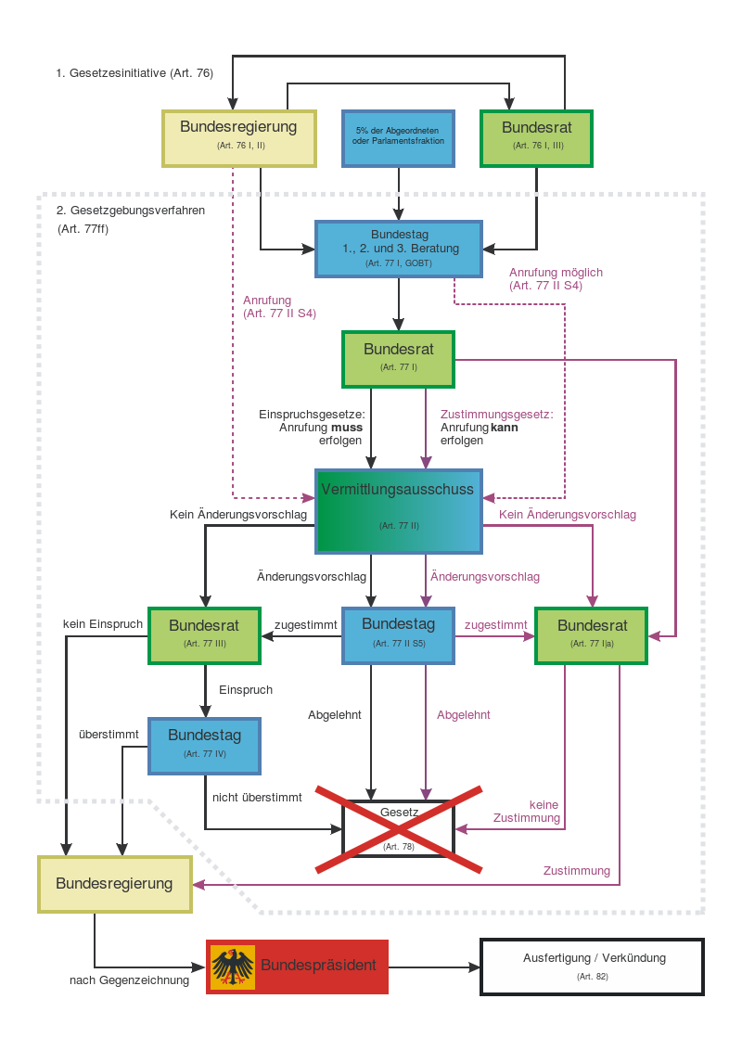

Slide 19
IV. Bundesrat:
Looks confusing?
Let‘s break it down
The Bundesrat is included in every case of federal legislation, however the Bundesrat‘s amount of influence is determined by the „nature“ of the bill:
There are so called „Zustimmungsgesetze“ (law requiring approvement) and there are „Einspruchsgesetze“ (law that can be appealed by the Bundesrat)

Slide 20
IV. Bundesrat: Zustimmungsgesetze
Laws that change the constitution: Need the approval of 2/3 of the Bundestag as well as the approval of 2/3 of the Bundesrat
Laws that have effects on the finances of the Länder: Especially tax laws, on which the Länder or Kommunen (Communes) have a share on (e.g.: wage tax, income tax)
Laws, which have to be executed by the „Länder“ and modify the laws of the „Länder“ concerning their administration
→ About 40 percent of all federal laws

Slide 21
IV. Bundesrat: Einspruchsgesetze
Every other federal bill that which does not fit the foresaid requirements

Slide 22
IV. Bundesrat: How does this distinction make a difference on the Bundesrat‘s influence on legislation?
„Zustimmungsgesetze“ need the approval of the Bundesrat in order to get legal validity
„Einspruchsgesetze“ do not need the approval of the Bundesrat, however the Bundestag has to vote again on the law if it is blocked by the Bundesrat
→ Depending on the topic the Bundesrat can either block a federal law temporarily or for good!

Slide 23
IV. Bundesrat: Vermittlungsausschuss
In order to avoid a possible blockade by the „Bundesrat“ there is the possibility to demand a mediation committee („Vermittlungsausschuss“)
Consists of 16 members of the „Bundestag“ (1st chamber, composition is normally propotional to the size of the parliamentary groups) and 16 representatives of the „Bundesrat“ (1 representative per „Land“)
Task: Working out a compromise
→ Neither the Delegates of the Bundestag are bound on directives nor the representatives of the Länder
→Negotiations are strictly confidential
→Between 1949-2008 there were 836 bills in the hands of these mediation committees, only 11 percent fell through
→Highly successful

Slide 24
IV. Bundesrat: Conclusion
The „Bundesrat“ (and therewith the „Länder“) has a a lot of influence on the legislation in regard to „Zustimmungsgesetzen“, since its approval is needed. A compromise that is also acceptable for the „Länder“ has then to be found.
Thanks to that the specific interests of the „Länder“ as well as the expertise of the administration (which is mainly done on „Land“ level) become part of the legislation.
By integrating the „Bundesrat“ on a very early stage (Statements regarding law initiatives by the government) possible „points of frictions“ are detected from the start.
Since the negotiations of the mediation committee are confidential, they are not as prone to the danger of being misused for politic gains and are therefore reasonably effective.
The Bundestag is not only a „control council“ for legislation that simply says „yes or no“, but plays a crucial role during legislation.

Slide 25
V. Impact of the discussed constitutional reforms on the „Senato“
(1)
Current structure of the „senato“ and its competences
  315 senators
  Bicameralismo perfetto: „Senato“ is involved in federal legislation as much as the first chamber (camera die diputati), which means that no law can pass without the cooperation and approval of the „senato“
  Senators are elected in a immediate election by the local population

Slide 26
V. Impact of the discussed constitutional reforms on the „Senato“
Art.1 riforma: Revokes the autonomy of the senato by taking its independent legislative powers and replaces those with control competences
  Verifies acts of the public administration
  Verifies the execution of federal law
  Verifies effects of European politics on its territorial entities
  Acts in general as a link between the parliament and the other constitutional bodies

Slide 27
V. Impact of the discussed constitutional reforms on the „Senato“(3)
Article 2: Changes in the structure of the „senato“, only 100 senators, that represent regional/local territorial entities
  74 consigli regionali
  21 sindaci
  5 senators that are nominated by the president of the Italian Republic
Consigli regionali and sindaci hold their offices as senators thanks to their functions in the local/federal government
All senators have complete parliamentery immunity

Slide 28
V. Impact of the discussed constitutional reforms on the „Senato“ (4)
Conclusion: In principle the new Italian „Senato“ has similarities to the German Bundesrat
  No adequate second chamber in regard to its involvment in federal legislation
  No direct elections of the senators, those are representatives of the regional and local entities
  →It can be said, that in regard to its structure the „Bundesrat“ is indeed a blueprint for the „senato“, however, that is not the case for its influence on legislation!

Slide 29
VI. Impact of the reforms on the state‘s structure
(1)
  Its important to realize, that there is not only a reform of the second chamber but also one, which redistributes legislative competence of the federal state and the„regioni“
    Framework legislation would be abolished and the competences are mostly transfered to federal legislation
    Additionally to this increase of federal legislation the remaining competences of the „regioni“ would be undermined by the new Art. 117 4 comma which establishes a new „clausola di supremazia“

Slide 30
VI. Impact of the reforms on the state‘s structure (2)
Regarding the actual distribution of competences there is a significant shift of power towards federal level (centralization!)
  Legislative competences are delegated from the „regioni“ to the federal state
  This could be balanced by the new „Senato“ and the respective inclusion of the „regioni“
  However, the new „Senato“ would have too little influence on the legislation, to actually be a corrective
  Furthermore, the reforms do not apply to the autonomous „regioni“, whereby the existing asymmetry among autonomous and remainig „regioni“is intensified

Slide 31
VII. Is German federalism actually a blueprint for the constitutional reforms?
Concerning the structure of the „senato“, the question can be affirmed
However, the German federalism is distinguished by the strong legislative and executive competences of the „Länder“
Additionally, the „Bundesrat“ plays a major role in the legislative procedure, since it assists in every bill, whereupon 40 – 50 % requires its approval („Zustimmungsgesetze“)
Alltogether the opening question can be negated with the weak situation of the „regioni“ in mind
This reform might be more like a step back towards the centralist origins of the Italian Republic

Slide 32
VII. Is German federalism actually a blueprint for the constitutional reforms?
There is definitely not an easy answer to the question whether this centralization can be valued positively or negatively
  The „senato“ in his present form certainly is in need of reforms
  The German system was not simply inaugurated but has grown over many years, therefore it is in question, whether this system simply can simply be adopted in another country
  Especially with regard to the different problems, Italy has to deal with, particularly the bigger disparities on its territory

