Slide 1

WILLIGNESS TO PAY FOR CHILDHOOD ASTHMA RISK REDUCTION: A STATED CHOICE EXPERIMENT WITH CHILDREN funded by the colt foundation
Work Funded by The Colt Foundation
Improving health worldwide
www.lshtm.ac.uk

Slide 2
Economic Evaluation of Environmental Health Interventions (EHIs)
Cost-benefit analysis (CBA): evaluates the social gain associated with a given intervention by comparing the benefits (any increase in welfare) and the costs (any decrease in human wellbeing) using a common monetary metrics.
E.g. of EHIs: air pollution interventions ; toxic waste site remediation; strategies to preventing/controlling radon exposure etc.
Source: Pearce. 1984. Oxford Review of Economic Policy
Notes:
Different types of economic evaluation (Cost-Effectiveness, Cost-utility, Cost-Benefit ) that can be performed to provide evidence on the cost and on the effectiveness of interventions affecting human health.
CBA is preferred to CEA and CUA

Slide 3
Examples of CBA of EHIs
In US: By 2020 the Clean Air Act is expected to prevent 230.000 adults deaths and 280 premature deaths among children. The Act also affects morbidity preventing for example 2,400,000 cases of asthma exacerbations each year. The estimated monetary benefits is $2 trillion vs. $65 billion costs (Environmental Protection Agency 2013).
In Europe: Clean Air For Europe project assessed the monetary net benefit of European air quality policy development. In 2030 the health benefits alone are expected save society €40-140 billion in external costs and provide about €3 billion in direct benefits due to higher productivity of the workforce, lower healthcare costs, higher crop yields and less damage to buildings (CAFÉ 2014).
In Campania: There are estimated to be 848 cases of premature mortality and 403 cases of fatal cancer per year as a consequence of exposure to toxic waste. The present value of the benefit of reducing the number of waste associated deaths after adjusting for a cancer premium is €11.6 billion (Guerriero & Cairns: 2007. Environmental Health).
Notes:
States are required to adopt enforceable plans to achieve and maintain air quality meeting the air quality standards. State plans also must control emissions that drift across state lines and harm air quality in downwind states. As a part of the 1990 amendments to the Clean Air Act, Congress required the EPA to conduct "periodic, scientifically reviewed studies to assess the benefits and the costs of the Clean Air Act." In other words, Congress wanted to know whether the Act "was worth it." In the analysis the EPA used dose-response data from the scientific literature available at the time to estimate the effects of a given increment or decrement in the concentration of a given pollutant in the air. They combined these data with values associated with a given health outcome from economics data, reported in terms of cost per case, episode, symptom-day, and so forth. These data were combined with actual measurements of air quality and estimates of air quality if the controls had not been in place. Using the modeling strategies available at the time, the EPA estimated that the Act resulted in a 40 percent reduction in sulfur dioxide, a 30 percent reduction in oxides of nitrogen, a 50 percent reduction in carbon monoxide, and a 45 percent reduction in total suspended particles. The reductions in fine and larger particles were thought to be on the order of 45 percent, based on measurements of total suspended particles. Specific monitoring for particulate matter fractions had not been instituted at that time, so an extrapolation from total suspended particles was required.

Slide 4
Motivation:
All the CBAs conducted so far use adults estimates or cost of illness studies to value children’s health benefits. Many also exclude children’s health benefits from the analysis (EPA.2003. Children’s Health valuation Handbook).
The Cost of Illness approach undervalues the real benefits of averting disease.
E.g. the cost of a cancer case is higher than the cost of treatment, intangible cost should be included.
Adults’ WTP estimates might not reflect children’s preferences.
Preferences of individuals must be considered and included in the analysis as a source of value and are considered “sovereign” as a fundamental value for judging a project cost-beneficial.
According to welfare economic theory the children affected by the policy are the best judges of their own welfare.

Slide 5
Our core questions:
Can children, aged 7-19 years, provide rational answers to questions eliciting their WTP for health risk reductions?
Do children’s WTP estimates differ from those of their parents ?

Slide 6
Preview of Findings
Can children, aged 7-19 years, provide rational answers to questions eliciting their WTP for health risk reductions?
91% of children is willing to pay for the health risk reduction.
5% of children failed to understand WTP questions vs. 15% of parents.
The relationship between WTP, income, age and gender is consistent with a priori expectations in parents and children.
The results also suggest that there are similarities between parents and children.
Notes:
A strong age gradient was found in the scope sensitity test
Children and parents’ WTP increases with income.
In children and parents WTP decreases with age.
Both boys and fathers are willing to pay significantly more compared to girls and mothers.
Children’s’ and parents degree of trust in the relationship between environmental hazards and health does affect both: the likelihood of agreeing to pay for health risk reduction and the amount paid.

Slide 7
Preview of Findings
Do children’s WTP estimates differ from those of their parents ?
Independently from the size of the health risk reduction, parents are willing to pay a significantly higher percentage of their budget to reduce their child’s risk of having an asthma attack.
Notes:
A strong age gradient was found in the scope sensitity test
Children and parents’ WTP increases with income.
In children and parents WTP decreases with age.
Both boys and fathers are willing to pay significantly more compared to girls and mothers.
Children’s’ and parents degree of trust in the relationship between environmental hazards and health does affect both: the likelihood of agreeing to pay for health risk reduction and the amount paid.

Slide 8
Presentation outline:
Literature on valuing children’s health benefits
Description of the contingent valuation study
Methodology used in the study
Results of the study
Future research questions

Slide 9
Valuing health benefits to Children:
Children are different from adults in respect to their risk, exposure and susceptibility to environmental hazards.
The environmental proportion of the global burden of disease ranges from 25 to 40%, but 43% of the total environmental burden of disease fall on children, in particular very young children.
Difference in risk
Difference in exposure
Dose-response difference
Notes:
: Exposure to environmental hazards during the gestational period increases the risk of congenital malformations. During their first years of life children are more vulnerable to environmental related risks because their bodies are still developing and are less able to protect themselves from the effects of pollutants. : Children’s faster metabolism exposes them to higher doses of food, water and air per unit of body weight.
The relationship between environment and children’s health has been the subject of
an increasing interest these last ten years. This interest has resulted in a growing number
of epidemiological studies aiming at establishing a causal link between environmental
pollution and the health of children. However, the valuation of children’s health strongly
differs from the valuation of adults’ health in several respects and constitutes a real
challenge for analysts as well as for decision-makers. On the one hand, one can note a
difference in terms of risk between adults and children. From their daily behavioural
pattern, adults and children are exposed neither to the same environmental risks, nor to
the same level of risk. Also, from a metabolic point of view, children are more receptive and
more sensitive to pollution than adults, as their bodies are still developing. Thus, even
though they are exposed to the same environmental risk and to a level a priori identical to
that of adults, the body of a child can be more affected than that of an adult by this form of
pollution. Recent epidemiological studies highlight the particular susceptibility of children
to environmental pollution (Tamburlini, 2005).

Slide 10
Valuing Health Benefits: methods
Basic approach | Main subsets | Evaluation methods
Human capital |  | Cost of illness
Willingness To Pay | Revealed Preferences | Hedonic wage method Travel cost Analysis
 | Stated Preferences | Contingent Evaluation Stated Choice
Notes:
As a result, the most popular approach adopted in cost-benefit analyses is the WTP approach. The WTP method can be divided in two main categories: revealed and stated preferences. The revealed preferences approach uses information from actual behaviors to elicit how much individuals are willing to pay (e.g. price of a bicycle helmet) for reducing health risks, or how much they are prepared to accept for facing a health risk (e.g. wage rate relate to the risk of fatal accident while at work).
It has been suggested that revealed preference techniques provide the most reliable indicator of preferences because estimates are based on actual decisions, rather than on individual choices under hypothetical scenarios [1]. In many cases, however, WTP information cannot be inferred from the market. Sometimes markets do not yet exist for the effect or cost being evaluated. Or, where EHIs target children and the elderly, the subjects are outside the workforce
Stated choice methods are another approach that can be used to elicit WTP/WTA values for changes in environmental-related health risk. In stated choice studies individuals are directly asked how much they would be willing to pay for an improvement in their health status, or their willingness to accept values for an increased risk. Compared with the revealed preference approach, stated preference methods can be used to value any type of risk including latent risks, risks for which there is a lag between the exposure and the onset of the health outcome, and hypothetical risk reduction scenarios (changes in risk arising from policy interventions not yet implemented).
Compared with the COI, stated preference approach has the advantage of taking into account the intangible consequences, for example: premature death and the suffering from an illness. In addition, stated preferences methods can also be used to elicit WTP estimates from individuals who are not in the labour force, and can easily account for different types of risk context.
There are two stated preference techniques for estimating WTP/WTA for environmental health risk reductions, these are: contingent valuation and discrete choice experiments. The Contingent Valuation (CV) approach asks respondents to make a monetary evaluation of the change in health risk presented. Among the many methodologies for eliciting WTP/WTA values from CV studies, the most common methods are dichotomous choice, open-ended and payment card format[1]. All the elicitation formats have certain advantages and disadvantages. For example, compared with dichotomous choice and payment card format, the open-ended format has several major advantages, which include: avoiding starting point bias, avoiding range bias and also avoiding anchoring bias [1]. However, this method is rarely used given its wider cognitive demands, which often produce non-response or a high proportion of protest and zero answers [1]. The payment card elicitation method presents respondents with a series of ordered amounts (from the smallest to the largest) and usually asks respondents to indicate the maximum bid they would likely pay for the health risk reduction [1]. But the payment card is also subject to bias because it requires the analyst to make assumptions about the range and the number of price bids . Compared with open-ended and payment card formats, the single and double bounded elicitation methods are less cognitively demanding. However, both these approaches also have weaknesses. Close ended formats leave less freedom to the respondents to select the exact amount they are willing to pay [15]. And both approaches are also subject to anchoring [1].
Unlike CV studies that directly ask respondents how much they are willing to pay for a specific change (e.g. in health risk), discrete choice experiments (DCEs) present respondents with a number of choice sets in which alternatives, described as a set of attributes, are mutually exclusive [16]. The alternatives presented in each choice set vary in one or more attribute levels. The selected combination of attributes is used to infer indirect information on individual preferences about the parameters considered. Compared with the CV technique, DCEs are able to describe a choice situation with a range of attributes that reflect the different characteristics of the particular good being valued and, when the cost factor is included, they allow WTP estimates to be made for changes in different attributes [15].
Despite the advantages of stated preference methods (e.g. elicit WTP for policies not yet implemented) several authors have suggested that their use of hypothetical scenarios may lead to significantly biased WTP estimates. Hypothetical bias refers to difference between the real payments that respondents make and a stated hypothetical willingness to pay provided in the questionnaire. Hypothetical bias has been found in stated preferences experiments for both private and public goods [1, 17]. Evidence from previous studies suggests that hypothetical bias is positively related to the size of the estimated values, it is smaller for WTP compared to WTA studies and it is highly affected by the presence of uncertainty [1, 18, 19]. Recent research investigating methods to reduce hypothetical bias suggest that the use of entreaties such as cheap talk may significantly reduce hypothetical bias in stated choice experiments. For instance the study conducted by Brown et al. showed that the content of ‘cheap talk’ used before asking WTP questions such as urging respondents to act as if they were really asked to spend the money , explaining what is hypothetical bias and how it can influence the study results, can significantly reduce the degree of hypothetical bias[18].

Slide 11
Valuing Health Benefits to Children: Which Perspective?
“Due to their immature cognitive ability, children do not have well-defined preferences over the full range of health and safety alternatives. In addition, they do not have control of the financial resources required to make trade-offs between money and health. In short, the basic tenets of welfare economics cannot reasonably be assumed to represent children.” (EPA 2003)
“The calculus of willingness to pay now seems to break down since children may have no income to allocate between goods, including risk reduction, may be ill-informed about or be unaware of risks, and may be too young to articulate preferences”. (OECD 1996)
“The choice of the perspective is a major concern when valuing children’s health. The WTP for environmental health risk reductions cannot be directly elicited from children because of children’s limited cognitive abilities, and little or no control over money“. (OECD 2006)
“Perhaps, the most important challenge in children’s health valuation relates to the impossibility of directly eliciting preferences from children since they do not have command over resources to make trade-offs in actual markets, and may not have the maturity to make such trade-offs in a hypothetical market». (OECD 2010)
Notes:
As a final note, analysts may often lack information on risk and/or valuation, making it difficult to
present first-best valuation estimates specific to children in any analysis.9 In these cases, analysts
should choose one of two alternatives as appropriate. As a second-best option, they might wish
to transfer benefit values estimated for adults to children. Transferred adult values should be
accompanied by a qualitative description of expected differences between children and adults.
Together, Chapters 2 and 3 give guidance for this type of analysis. Box 1.1 shows several
examples where EPA and other agencies have relied on adult values for morbidity and mortality
risk reductions to children. These examples highlight the need for research and analysis targeted
at finding values for children’s health effects. As a third-best option, analysts facing an absence of
appropriate values for transfer might choose to analyze impacts via cost effectiveness, breakeven,
or bounding analyses. Chapter 5 gives guidance for these kinds of analyses.

Slide 12
Valuing Health Benefits to Children: Which Perspective?
Three approaches have been used to assign monetary values to children’s health benefits:
Societal perspective
The parental perspective
The adult as a child perspective
.
Notes:
Information deficiencies: Parents might not possess complete information regarding
children’s health and safety risks. For instance, uninformed parents might not be aware of
the impact some of their own actions have on the welfare of their child and may engage in
actions that contribute to illness or injury in their own children. Dickie and Nestor (1998)
note some of these actions, including parental smoking, failure of parents to manage
childhood asthma, and resistance to the use of child safety seats. Of course, a similar
concern can be expressed regarding adult ignorance of consequences to his own health
caused by similar actions, such as smoking. That parents are intermediaries representing
children’s interests, however, suggests a greater likelihood of ignorance because the child,
and not the parent, actually experiences the consequences.
Paternalistic altruism refers to the situation in which the individual utility function depends on the consumption of other individuals of a particular merit good (e.g. size of the health risk reduction to the child). The non-paternalistic altruist’s utility function depends instead on the others’ welfare (e.g. child’s utility level).
If the marginal utility of additional consumption is zero for the person consuming the good, higher levels of consumption would not have a positive value to a non-paternalistic altruist but could have to a paternalistic altruist.
Example of paternalistic vs. Non paternalistic altruism. “paternalistic” altruist cares about some particular aspects of a person’s
well-being (e.g. the level of consumption of safety), but he/she does not take
into account this person’s utility in general. This is often referred to as
safety-focused altruism. In contrast, a “non-paternalistic” altruist only cares
about the general utility level of others (determined both by the level of health
and safety they enjoy and consumption of other goods and services). The paternalistic altruist has positive WTP for risk reductions to others even if
their utility levels remain unchanged. If everybody pays the maximum of what
they are willing to pay for a risk reduction accruing to themselves, their utility
levels would remain unchanged as would the levels of non-paternalistic
altruists. Failing to realise this and adding the WTP of non-paternalistic
altruists for the increased utility levels of others from risk reduction would
lead to “double counting”. Hence, adding the WTP of the non-paternalistic
altruist to that of the individuals themselves (or their parents as a proxy)
would be inappropriate. As such, it is preferable, and generally agreed, to only
account for the WTP of the “paternalistic” altruist (Takeuchi et al. 2008;
Harbaugh, 1999; Jones-Lee, 1991 and 1992).

Slide 13
Previous Literature on Children:
Are children rational?
A study conducted by Harbaugh et al.(2001) show that even young children present a low number of trasitivity violations and that the number decrease significantly from 7 years old to 11 years old (Harbaugh et al. 2001 American Economic Review).
Do children understand health risks?
No study available.
Do children understand money related concepts?
Berti and Bombi in 1984 explored children’s (between 3 and 8 years old) understanding of economic ideas. The authors concluded that children acquire basic economic concepts through stages and their ability improves significantly with age(Berti & Bombi 1984.Child Development).
Are children financially autonomous?
Children’s use of money has been investigated in many studies but never in Italy. Previous findings show that parents introduce the allowance system quite early (when the child is 6 years old) and increase the amount given as the child ages(Furham 1999; Webley et al. 2001. Journal of Economic Psychology).
Notes:
) Studied transitivity of choices among 7- and 11-year-old children and college undergraduates. Individuals in the study were presented with 11 choice sets, in each choice sets there was a list of between three and seven bundles, each bundle contains a number of small bags of potato chips and boxes of fruit juice. The study results show that even young children present a low number of GARP violations (4.3) and that the number decrease significantly from 7 years old to 11 years old (mean: 2.01) (Harbaugh et al. 2001 American Economic Review).
Do children choose rationally? This question
matters for several reasons. If children are incapable of choosing rationally, then there is little point in attempting to use standard economic models to describe their behavior. The issue of rational choice by children is important both for justifying this paternalism and for determining the effectiveness of incentive-based mechanisms for enforcing it. It is also difficult to justify using data on children’s choices to draw inferences about their preferences, or to accurately predict their future behavior, if the choices are not rational.
In addition to these reasons, which apply to children as children, there is the fact that children grow into adults. An understanding of the development of rational choice behavior over the lifespan may ultimately tell us something about rational choice by adults .
If a person picks A when given a choice between A than B, and B when given a choice between B and C, then barring indifference rationality requires that he must pick A when given a choice between A and C. We also examine how rationality, as measured by several different tests of transitivity and by a simple measure of the size of the violations, changes with age and mathematical ability. Hal R. Varian (1982) refined the main theorem in Afriat’s paper, and proved that satisfying
the Generalized Axiom of Revealed Preference (GARP) is a necessary and sufficient condition for choice data to be consistent with the maximization of a continuous, concave, locally nonsatiated, and weakly monotonic utility
function. This means that if choices satisfy GARP we lose nothing by using standard economic models to analyze behavior. The study assumed that children have problem in doig the maths within a budget constraint
The study tested for ratioanlity using GARP however the authors strenghten from weak to strong mononic utility funcsions However, if we assume utility functions are strongly monotonic, we can use revealed preference to test rationality. Now we can use these choices to say u(a) > u(b), since a was chosen
over d, which by strong monotonicity must provide more utility than b. A similar argument
would imply u(b) > u(a), since b was chosen over c 5 (4,2) which must provide more utility than a 5 (3,2). Afriat’s (1972) efficiency index, a measure of
the severity of the GARP violations.2 Afriat Index The index e measures the overall efficiency of
the participants’ choices, or 1 2 e measures the proportion of income that a person wasted by making the choice that violated revealed preference. Some
revealed preference violations are present at all ages. Even the youngest children have considerably
fewer and less severe violations than would be expected if they were choosing randomly. The number of violations decreases noticeably from
age 7 to 11. From age 11 to 21, there is only a small and insignificant further decrease in the rationality of choices
Conclusions:
Using this experiment, we find that at age 7 children’s choices about consumption goods show clear evidence of rationality, though also
many inconsistencies. By age 11, choices by children with below-average mathematical ability
are as rational as choices by adults with above-average intelligence, although even these adults’ choices show many inconsistencies. Based on our results, we conclude that, to the extent the assumption of utility maximization is
useful for modeling choice behavior by adults, it is also appropriate for children.

Slide 14
Previous results from my studies:
Study investigating children’s understading of health risk:
Children as young as 7 are able to provide accurate answers to health risk questions
the ability to understand health risk increases with age (in particular when children reach the age of nine).
Study investigating understanding and use of money among children:
The ability to understand money-related concepts increases with age.
The majority children aged 7 up to 13 years received pocket money from their parents and the amount of money received increases with age. I used the results of this study to estimate the median budget by age group.
Notes:
RISK
It is difficult to establish an a priori threshold for the age from which it becomes possible to elicit WTP estimates directly from children. Previous willingness to pay studies show that even adults experience difficulties in grasping concepts about their own health risks. In a contingent valuation study conducted by Krupnick et al. 12% of the respondents choose the “Wrong person” when asked which person 1 or 2 was at higher risk of death (risks were presented using coloured squares scattered over a grid)[43]. The objective of this piece of work was to provide preliminary evidence on the ability of children to grasp health risk information and to provide reliable (e.g. scope-sensitive) answers to willingness to pay questions. From this study we may infer that the ability to understand risk information, when provided with appropriate visual aids in willingness to pay questions will be likely to increase as children get older. MONEY: There are difficulties in establishing an a priori age threshold above which it becomes possible to obtain WTP estimates from children. Indeed, it has been shown that adult respondents do not consider budget constraints when answering WTP questions[36]. The main objective of the two experiments described in the present study is to provide evidence of an age gradient in the use and understanding of money. Both the experiments show that as children grow older, and in particular when they turn 9, they have both a higher ability to understand money related concepts and also display a higher degree of financial autonomy. In order to compare the use and understanding of money among wider age ranges, including also adolescents and adult individuals, additional research is necessary. For example, a study involving a larger sample and older age groups might provide further insights on the development of the use and understanding of money across different age groups.

Slide 15

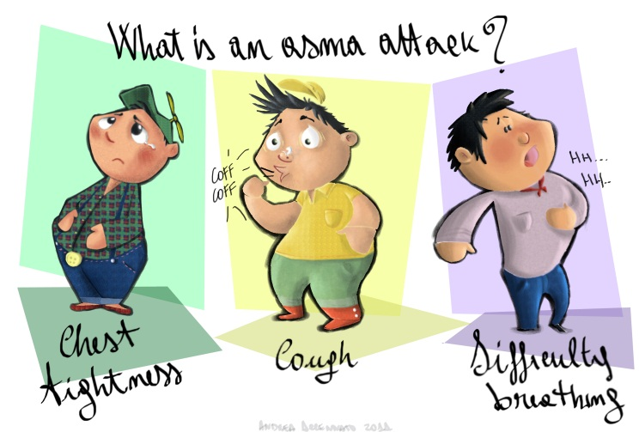
The study: Hypotetical scenario valued
Imagine that you are Jack. Jack is a boy living in a polluted city where 20 children in 100 have an asthma attack each month. Imagine that it is possible for Jack to pay a monthly amount to implement a policy intervention to reduce the risk of having an asthma attack. Remember Jack has a monthly budget constraint of €32
Asthma Attack
Jack

Slide 16
Description of the study
Sample: 370 children aged 7-19 years & 173 parents from elementary, intermediate & high school in Napoli (Italy)
Elicitation Format: Payment Card with age-specific budget constraints for children & a pre-assigned budget for parents
Health risk reduction: Baseline monthly risk 20 in 100 children have an asthma attack;
WTP1: 1 in 100 children has a asthma attack
WTP2: 10 in 100 children have an asthma attack
WTP3: 19 in 100 children have an asthma attack
Information collected from children & parents:
Demographic & Socio-economic variables (Age, Gender, monthly income, type of job, family size)
Attitudinal and behavioral variables:
Trust in the relationship between environment and health (5 point Likert scale)
Altruism: generic measure, welfare related , health related and non-paternalistic altruism
Risk aversion: 5 measures of health risk aversion , 5 measures of recreational risk aversion
Care for own health & for parents degree of care for children’s health (5 point Likert scale)
Notes:
The main objective of this study was to quantify the WTP for three health risk reductions of asthma attack from both a child and a parental perspective.

Slide 17
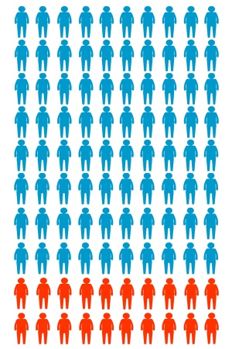
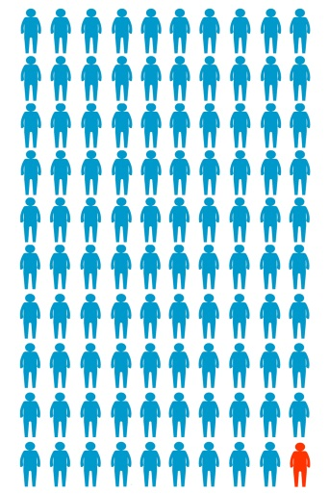
If you were Jack would you be willing to pay to decrease the risk of having an asthma attack?
Yes No
Contingent Valuation questions
If your answer was Yes remember that your monthly budget is €32 & answer the following questions:
If you were Jack, how much would you be willing to pay to reduce the risk of having an asthma attack from 20 in 100 to 1 in 100 children: (See Visual Aid provided)
20 in 100 1 in 100
(Please cross the selected amount in the list below)
€0 | €2 | €4 | €10 | €26
€1 | €2.50 | €6 | €13 | €30
€1.50 | €3 | €8 | €20 | €32

Slide 18
Methods
Objective 1: To assess if children can provide rational answers to CV questions
Test Face validity:
Analysis of “No” answers to the initial WTP question
Scope Sensitivity:
Test 1 verifies whether individuals displayed a decreasing WTP for higher health risk reduction (WTP1<WTP2<WTP3).
Test 2 combines results of two different tests: 1) WTP1=WTP2=WTP3 and 2) WTP1=WTP2=WTP3=Y
Test 3: Testing if individual’s characteristics influence Scope Sensitivity:
Logistic regression analysis to investigate whether children’s and parents’ characteristics, attitudes and behaviours influence the likelihood of agreeing to pay for health risk reductions.
Yes/No = f (characteristics, attitudes, behaviours)
Notes:
A problem with CV questions is to understand why respondents refuse to pay the WTP questions also referred as the problem of non response ..
We can have three options: respondents refuse to answer to the questions 2) respondents do not provide a genuine answer and reply zero 3)respondents do not provide a genuine answer and respond with an unrealistic high value. The latter two forms of non response are know as protest bids protest bids are analysed through follow up questions and identified and individuals with protest bids are excluded from the analysis if the % of protest bids is too high the survey is not well designed or the individuals are not able to understand the hypothetical scenario.. Survey with high % of protest bids do not allow to estimate welfare estimates this issue is also referred as face validity to assess whether the questionnaire asked the right questions in an appropriate manner to obtain a valid estimate this is particular important for children because we have no previous studies to refer to for the construction of a valid scenario
where Yes or No is a dichotomous response to the initial WTP question, characteristics, indicates all the demographic and socio-economic variables collected from respondents.

Slide 19
Methods
Theoretical Model: The Bid Function
Indirect utility function: V(Y,P,Q,S)
The utility enjoyed by the individual is higher for higher provision of the non-market good:
V(Y,P,Q⁰,S)<V(Y,P,Q¹,S)
Given C the WTP for the non-market good:
V(Y,P,Q⁰,S)=V(Y-C,P,Q¹,S)
C can be defined as a function of the other parameters in the model:
True bid function: C(Q⁰,Q¹P,S,Y)
WTP must be bounded between 0 and Y :
0≤C(Q⁰,Q¹P,S,Y)=WTP≤Y
Analyst bid function: c(q⁰,q¹,p,s,y,e)
One specification for the analyst bid function is the constant only bid function:
Constant only bid function: C= a+e Where: a is the constant and e is the error term.
Notes:
The indirect utility function is the max amount of utility an household can derive from income Y given P prices of goods and level of provision of non market good Q. the household utiity will also depend on the socioe economic factors S.. We assume that an increase provision of the non market good will increase the utility , thus if the subject eperiences an increase in well being he will be ready to pay someting to achieve Q1 where WTP is the compensating variation meaure for a change in welfare C is itself a function of others parameters in the model another cnsideration is thta the household WTP is not greater than the discretionary income . Dscretionary income is a part of income that is left after ommitting for houseign accmodaiton food and also WTP is non negative . So WTP values given responents quesiton to CV is the solution of a constraiined utility maximiing problem the solution o fthis problem is also referred as bid fucntion the bid function related wtp to the characteristics of the non market good and to the individuals characteristics
The Cv respondent knows which are the factors important ot determine his utility function but the analysi does not so the analysis model is given by the risght part of the equaiton so you can see that the analysi inderect utity fucntion is just an approximation of the true one where e is the unobserved variation in tastes the bid fucntion isthe analys bid funtion which is different from the repsoendts one and the difference is given by
The consatnt only bid function i sthe simplest possible specification of the bid function and is of principal importance when estimating the mean WTP from CV surveys.

Slide 20
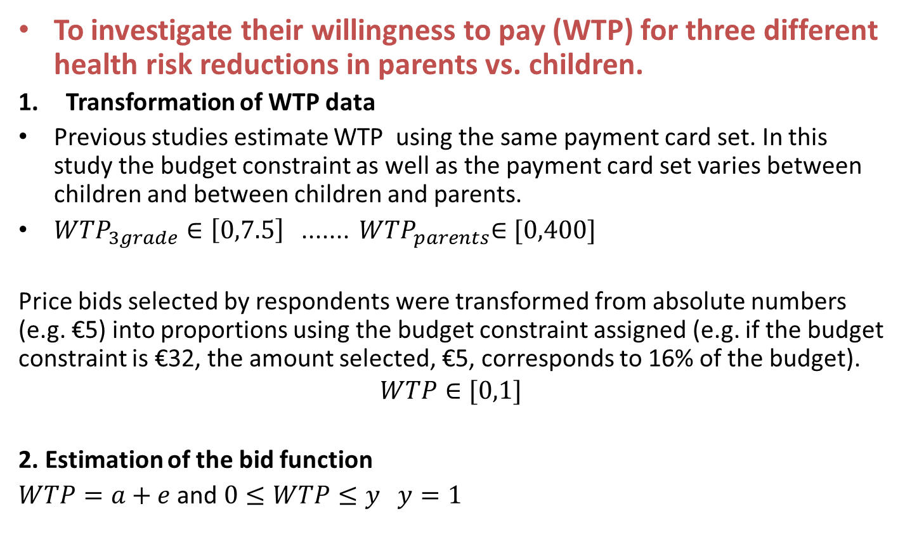
Methods
To investigate their willingness to pay (WTP) for three different health risk reductions in parents vs. children.
Transformation of WTP data
Previous studies estimate WTP using the same payment card set. In this study the budget constraint as well as the payment card set varies between children and between children and parents.
${WTP}_{3grade}∈\left[0,7.5\right]$ ....... ${ WTP}_{parents}∈[0,400]$
Price bids selected by respondents were transformed from absolute numbers (e.g. €5) into proportions using the budget constraint assigned (e.g. if the budget constraint is €32, the amount selected, €5, corresponds to 16% of the budget).
$$WTP∈[0,1]$$
2. Estimation of the bid function
$WTP=a+e$ and $0≤WTP≤y y=1$
Notes:
In this study we have continous data each respondent select among the bids levels one amonts that correspond to theri maximum WTP. A+ e is the bid function models is the WTP of the individual for a change in provision of non market good
a is the observable part of WTP e is due to variatons in tastes for the non market good income effects can be incorporated but in practice they are never done becasue we want a mean or median WTP value for the general populaiton indipendent from individuals’ characteristics..
Since e cannot be observed is a random variable.. To account for this randomness the WTP of any particualr household is drawn from a probability distributions. The choice of the probability distribution is based on two criteria whether the distributio account for the limits of the permissable values of WTP and ow well the distrbutions fit the data .. For the proportion data data are truncated at 0 and 1 a recent publications by Buis he suggest three possible options Beta, Zero inflated beta and GLm I tested the three options and according to akaiake criterion and the log likelohood the best fitting is the GLM.
We have to run a constant only model to estimate the mean WTP that is the a parameters should not be made a function of the covariates the choosed bid fucntion should fit the data best .. To choose the model the fit the data best use the value of the maximum likelihood to compare

Slide 21
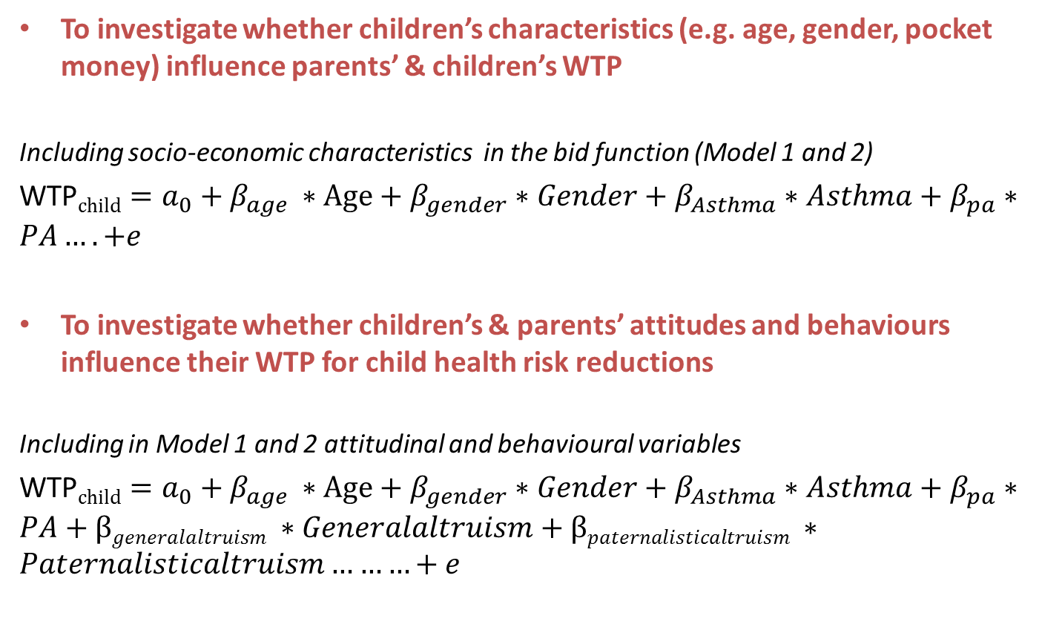
Methods
To investigate whether children’s characteristics (e.g. age, gender, pocket money) influence parents’ & children’s WTP
Including socio-economic characteristics in the bid function (Model 1 and 2)
WTP$child=a_{0}+β_{age }∗Age+β_{gender}∗Gender+β_{Asthma}∗Asthma+β_{pa}∗PA….+e$
To investigate whether children’s & parents’ attitudes and behaviours influence their WTP for child health risk reductions
Including in Model 1 and 2 attitudinal and behavioural variables
WTP$child=a_{0}+β_{age }∗Age+β_{gender}∗Gender+β_{Asthma}∗Asthma+β_{pa}∗PA+βgeneralaltruism ∗Generalaltruism+βpaternalisticaltruism ∗Paternalisticaltruism………+e$

Slide 22
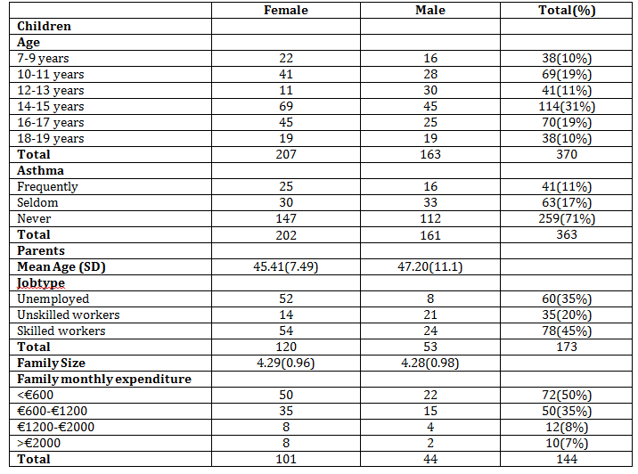
Results:
Descriptive statistics

Slide 23
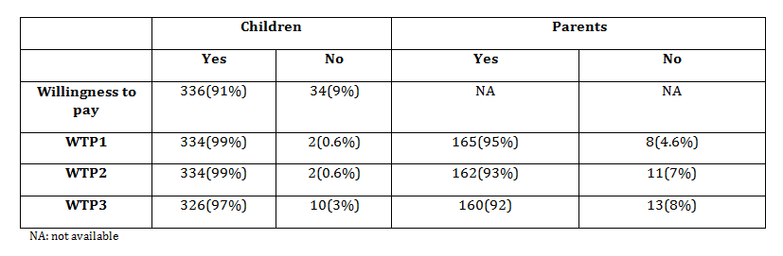
Results:
Testing for protest answers
Descriptive analysis of children’s answers to debriefing questions.
 | Yes % | No %
I do not care about health | 32% | 68%
The Mayor should deal with this problem | 85% | 15%
I do not have enough money to deal with this problem | 44% | 56%
I think there are other problems | 62% | 38%
The change in health risk was too low | 44% | 56%
Notes:
Highlighted there are the debriefing quesitons testing for protest answers

Slide 24
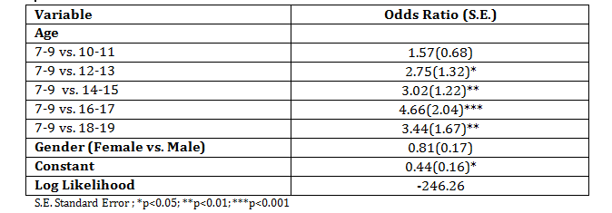
Scope sensitivity test:
Results:
Can children answer CV questions rationally?
Flag1 =1 | Children | Parents
Test 1 WTP1<WTP2<WTP3 | 12(4%) | 7(4%)
Test 2 WTP1=WTP2=WTP3 WTP=budget constraint | 4(0.89%) | 17(14%)
Regression results (WTP1>WTP2>WTP3)
Children
Notes:
In the case of parents the bok type unemplyed versus skilled job was stat significant
There remains a shocking paucity of evidence from large-scale, rigorous trial and non-trial designs on the costs, feasibility, effectiveness and impact of specific intervention approaches based on structural insights on the HIV epidemic.
We have failed to iteratively construct an evidence base that builds from fundamental principles, to test hypothesised pathways, to trying out and evaluating specific strategies
This gap must still be closed

Slide 25
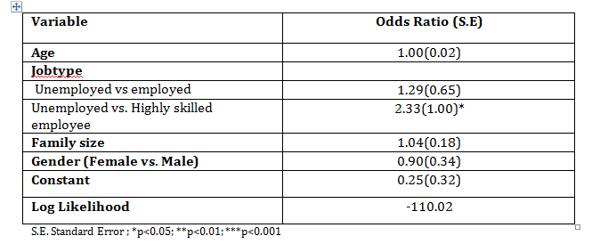
Scope sensitivity test:
Results:
Can parents answer CV questions rationally?
Flag1 =1 | Children | Parents
Test 1 WTP1<WTP2<WTP3 | 12(4%) | 7(4%)
Test 2 WTP1=WTP2=WTP3 WTP=budget constraint | 4(0.89%) | 17(14%)
Regression results (WTP1>WTP2>WTP3)
Parents
Notes:
In the case of parents the unemployed versus skilled job was stat significant

Slide 26
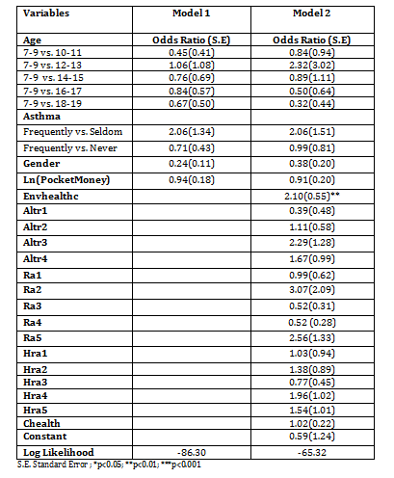
Results:
WTP: Yes or No
Logistic Regression. Children Willing to pay (Yes or No).
Notes:
The Table shows the results of the logistic regression investigating possible factors influencing WTP (yes or no) in children. As seen, for children, the trust in the relationship between environmental hazards and health was a strong predictor for deciding whether, in principle, they were willing to pay for a health risk reduction. In the case of parents, all the covariates were not statistically significant.

Slide 27
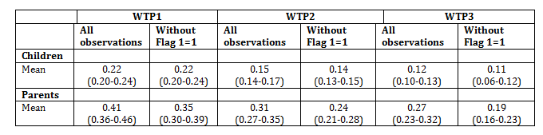
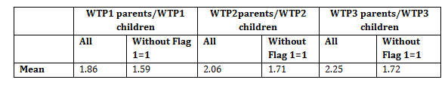
Results:
Willingness to pay as percentage of the available budget
Mean (95%CI) WTP as proportion of the available budget
Are the children’s WTP values different from parents?
Notes:
Tables shows the results of GLM constant only model for the entire sample (excluding protest answers) and separately for those who failed the Test 1 and 2 (Flag1=0). As expected, the mean WTP is significantly larger for higher risk reduction than lower risk reductions for both parents and their children. Among children who satisfied the rationality test, the mean WTP ranged from 22% for the highest risk reduction (19 asthma attacks in 100 children risk reduction ) to 11% (4-in-100 risk reduction)(Table 5.12). Among parents, the proportion of the budget they were willing to give up was significantly higher, ranging from 35% to 19% of the available budget. Parents WTP estimates (calculated by multiplying the parents’ proportion of the budget by the budget constraint used in the experiment €400) for 19, 10 and 4 in 100 risk reduction are €140, €96 and €76 respectively (See the Appendix 6 for the description of the different theoretical models). For children, however, WTP depends on the theoretical model used. Where it is assumed that children faced parental budget constraints (€400), the WTP is €88 (19 in 100 risk reduction), €56 (10 in 100) and €44 (4 in 100 risk reduction).
Table 5.13, reports the ratios of WTP estimates for different health risk reductions.
As shown, both children and parental WTP estimates are sensitive to the size of the health risk reduction. Nevertheless, they do not exhibit proportionality in relation to the size of the health risk reduction. These findings hold even where the analysis is restricted to those who passed both Test 1 and Test 2. Parents’ WTP per asthma attack averted is €7.3, €9.6 and €19 for 19 in 100, 10 in 100 and 4 in 100 health risk reduction respectively. As for the parents also for children the WTP is not proportional to the size of the health risk reduction. The corresponding WTP per asthma attack averted estimated using household budget and children’s perspective is, depending on the size of the health risk reduction: €4.6, €5.6 and €11.
Table 5.14 compares the WTP estimates for parents, divided by child WTP, for the same health risk reduction. As shown, parental WTP estimates always exceed those of their children, however, the difference narrows for highest health risk reduction.

Slide 28
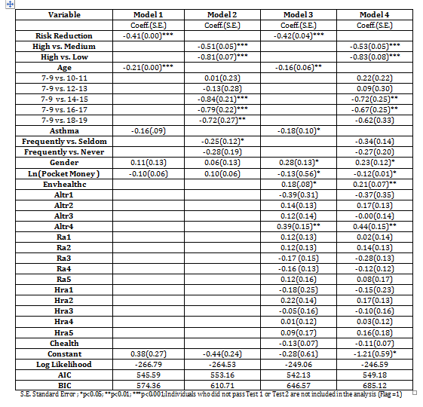
Internal validity test: Children sample results
Notes:
Table 5.15, presents the results of generalized linear regression model for those children who passed Test1 and Test2 (Flag1=0). Model 1 examines the effect of risk reduction size and socioeconomic characteristics such as age, gender and child asthma status on child and parental WTP for childhood asthma risk reductions by including covariates to the constant and the regression model. The WTP is highly related to the size of the risk reduction. As expected the higher the size of the health risk reduction the higher the WTP. However, the coefficient is lower than 1 indicating that, consistent with the results of previous studies, WTP is not proportional to the size of the health risk reduction.
In the case of children, the signs of the other coefficients are not known a priori for the reason that this is the first study to elicit WTP from their perspective. The statistically significant, negative coefficient of age indicates that children are willing to pay less for health risk reduction as they become older. The asthma coefficient is negative, indicating that the lower the frequency of asthma attack the lower the WTP for asthma health risk reduction. However, the coefficient is not statistically significant in Model 1. As for children, parental WTP is also significantly related to the size of the health risk reduction confirming the validity of the study. Surprisingly, the coefficient for parents is lower than for children, suggesting that child WTP is more proportional to the size of the health risk reductions. In Model 1, neither parental nor child age influence parental WTP for health risk reduction.
As seen in the correlation analysis, available household income (without accommodation and food expenses) is highly correlated with the parental job-types (Jobtype is 0= unemployed, 1= unskilled employee, 2= skilled employee). Thus, it is not surprising that there is a statistically significant increase in parents’ WTP as job status increases.
In order to provide greater flexibility in the analysis of child responses, Model 2 includes the age, the size of the health risk reduction and the asthma status as dummies. Where the age coefficients are expressed as dummies, WTP is similar among those aged between 7 and 13 years and decreases significantly for those 14 years or older whose WTP amounts are on average 75% lower than those of younger respondents. Rather than including asthma as single indicator, it is possible to include it as a separate dummy accounting for frequency of asthma attack. As a result, those who experience frequent asthma attack have a higher (+25%) WTP compared with those who seldom suffer from asthma. However, no difference was detected between those who suffer from asthma frequently compared with those who have never suffered it.
For the analysis of the parental questionnaire under Model 2, the size of the health risk reductions as well as Job-type were included as dummies. Interestingly, the model finds that the age of the child is negatively related with parental WTP. Results of model 2 also shows that parents employed in a highly skilled job have a higher WTP compared with unemployed parents. Marginal effects are also reported in Table 5.17 and 5.18 for children and parents respectively. Marginal effects provide information about the amount of change in WTP that will be produced by a 1-unit change in the independent variables. In the case of children, for instance, everything else equal, we would expect a 3% increase in WTP if the risk reduction offered by the policy changes from small to medium and a 10% increase if it changes from small to large risk reduction.
Model 3 of Table 5.15 re-runs the regression to examine the effect of child attitudes and beliefs on their WTP. Once children’s attitudes are controlled for, monthly pocket money becomes, all else being equal, negatively related to the WTP. A possible explanation for this is that the amount of the personal allowance indicates the degree of the child’s autonomy, the more children receive from their parents the more they are responsible for buying things that they need.
As evidenced in Model 3, once all four dummies measuring the different types of altruism are included in the model, only non-paternalistic altruism increases the WTP for health risk reduction. As expected, the majority of the coefficients used to measure risk aversion show a positive sign, indicating that more risk adverse individuals have a higher WTP. However, none of the risk aversions measures are statistically significant. Surprisingly, care for health was negatively related with WTP. Yet, the effect of this variable was not significant at the conventional levels. But, as expected, those who believe that the environmental hazards seriously affect child health have a higher WTP for health risk reduction.
Model 3 in Table 5.16 shows the effect of parental attitudes and beliefs on their WTP for childhood health risk reduction. As found with children, the stronger the parental belief that environmental hazards can affect child health, the more they are willing to pay for health risk reduction. In the case of parents, one measure of health risk aversion, ‘using sunscreen when sunbathing’ was significantly associated with higher WTP for child health risk reduction. As expected, the frequency with which parents smoke is negatively associated with WTP. However, smoking was not significant at a conventional level. Surprisingly, the frequency with which parents practice sport is negatively related with WTP for child health risk reduction however as for smoking the coefficient is not significant. An interesting finding of Model 4 is the contrasting sign of the two coefficients: care for own health and care for child health. The negative sign of care for one’s own health indicates that the less parents care for their own health, the more they are willing to pay (sacrifice part of their budget, given a fixed budget constraint) for reducing child asthma.

Slide 29
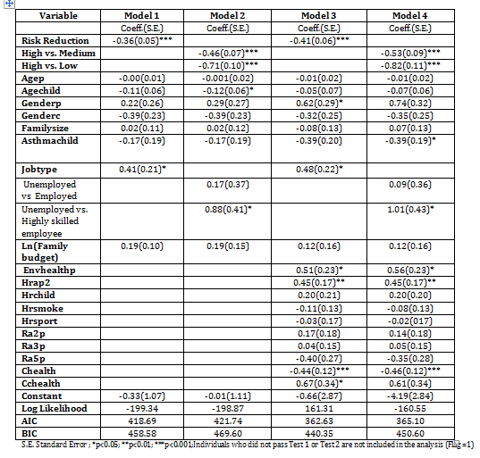
Internal validity test: Parents

Slide 30
Conclusions
For the majority of children WTP for health risk reductions increases with the size of the health risk reduction. The proportion of children that pass the scope test increases with age.
The average proportion of the available budget children are willing to pay ranges between 22% & 11% for a 1-in-100 & 19-in-100 risk reduction respectively.
Parents are willing to pay a higher proportion of their budget compared with children independently of the size of the health risk reduction (range: 35% to 19% of the available budget).

Slide 31
Conclusions
Children’s WTP decreases significantly as they get older
Boys are willing to pay more than girls. WTP increases with trust in the relationship between environment & health, and asthma status. The amount of pocket money is negatively correlated with a child’s WTP and being willing to give money to those who need it, is positively associated with WTP.
Parent’s job is a predictor of increased WTP for risk reduction to children. Parental trust in the relationship between environment & health is a predictor of WTP.
Parental care for their own health is inversely related to their WTP for health risk reductions for their children

Slide 32
Future Research
To investigate the external validity of adults’ and children‘s WTP estimates with CV elicitation methods.
Context of valuation is another key factor in estimating children’s health benefits. Are children’s preferences considered in the household decision-making? Which factors (e.g. age, whether the child works, cultural factors, household structure) influence children’s decision power?
If children are found able to express their preferences for future health benefits, research also needs to be undertaken to determine which factors influence their inter-temporal choices.
Notes:
Consistent with the principles of welfare economics, children from certain age groups may be the best judges of the value to them of their own health risk reductions. As a result, the child perspective may offer the best point of departure for estimating WTP values for child health benefits .

Slide 33
Thank you for your attention !!!

